Slide 1
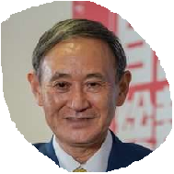
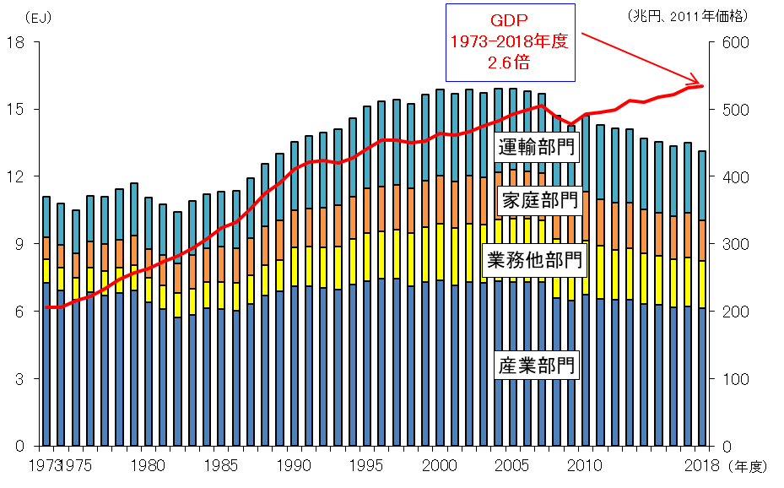
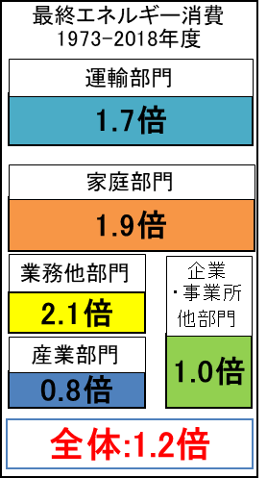
Can we realize net ZERO emission?
Energy consumption is decreasing gradually.
Energy White paper 2020, Agency for Natural Resources and Energy

Slide 2
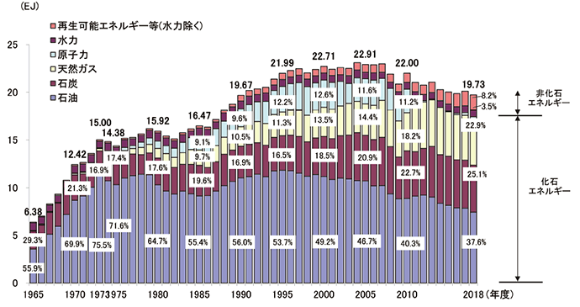
RE is gradually increasing while nuclear energy is fade-out.
Coal is still the large contributor, that cause divestment.
Energy White paper 2020, Agency for Natural Resources and Energy

Slide 3
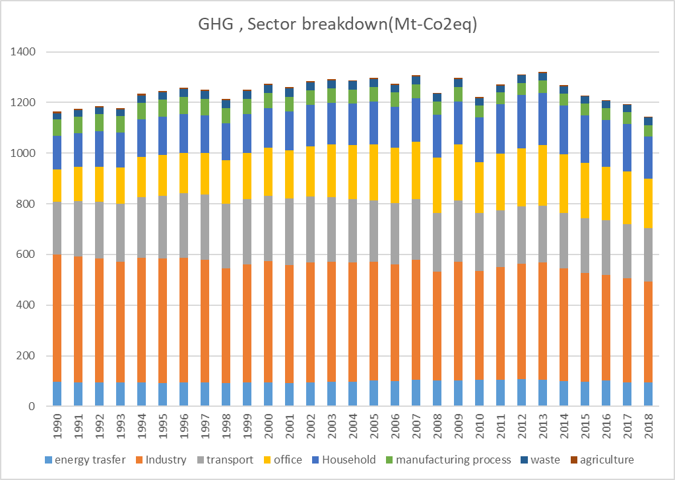
GHG is decreasing recently
ref 4-5 日本の部門別二酸化炭素排出量の推移（1990-2018年度） - JCCCA 全国地球温暖化防止活動推進センター

Slide 4
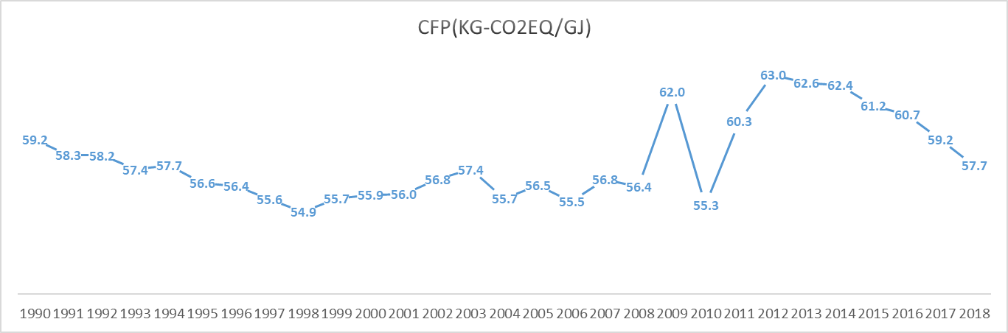
Carbon footprint of Japanese energy keep higher level.
Calculated by data from Energy white papre2020 and JCCCA

Slide 5
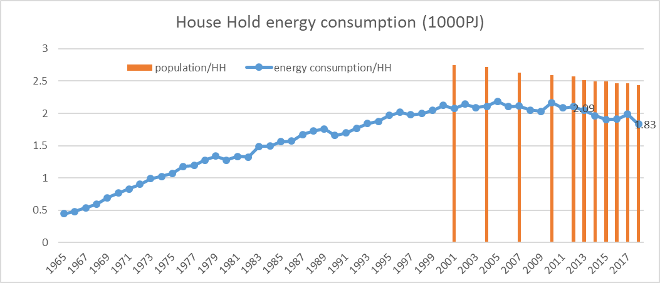
Total house hold energy consumption is gradually decreasing, population of each household is shrinking, though.
1) Energy White paper 2020, Agency for Natural Resources and Energy
2) 2019 KOKUMIN SEIKATSU KIDO CHOSA, Ministry of Health, Labour and Welfare

Slide 6
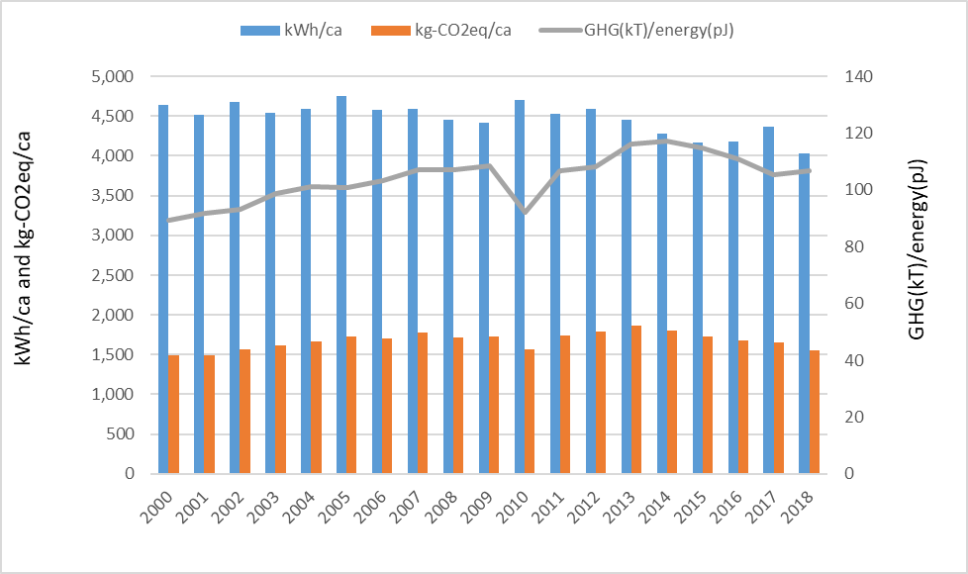
As for house hold sector, energy consumption per capita is decreasing but GHG emission / capita isn’t.
Thus, GHG emission intensity (gray line) is getting higher.
1) Energy White paper 2020, Agency for Natural Resources and Energy
2) 2019 KOKUMIN SEIKATSU KIDO CHOSA, Ministry of Health, Labour and Welfare

Slide 7
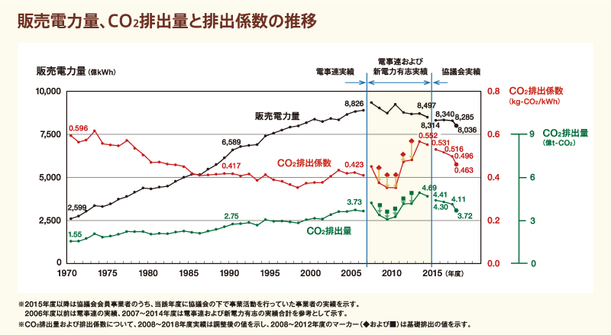
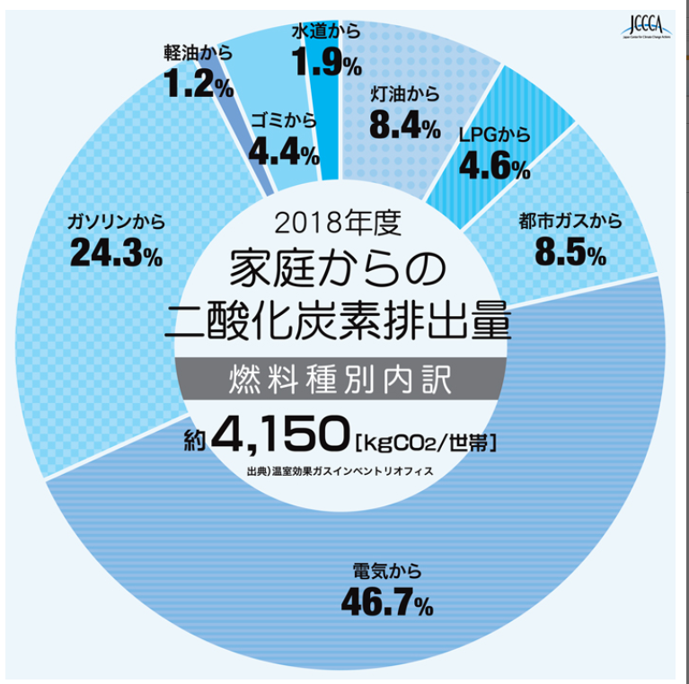
The majority of HH energy consumption is electricity, the CO2 emission factor of which is still high because of heavier contribution of coal burned power generation.
Ref: The federation of electric companies of Japan
CO2排出実績の分析・評価 － 地球温暖化対策 ｜ 電気事業連合会 (fepc.or.jp)
Ref: JCCCA

Slide 8

みんなでいっしょに自然の電気
Local gov. (Kanagawa,Tokyo,Saitama,Chiba, Yokohama,Kawasaki,Sagamiahra)
Promotion
Agent
Companies,
Residents,
Offices
Selection
agreement
Green power company
Current power supply: 0.468 kg-CO2e/kWh
RE power supply:
30% mix 0.393 kg-CO2e/kWh 0.2-7% cheaper
100% RE 0.198 kg-CO2e/kWh ?-4% cheaper

