Slide 1
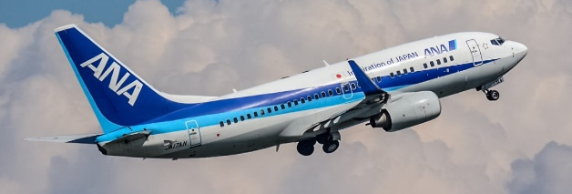
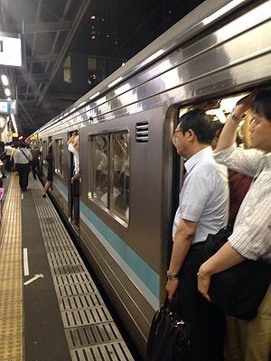
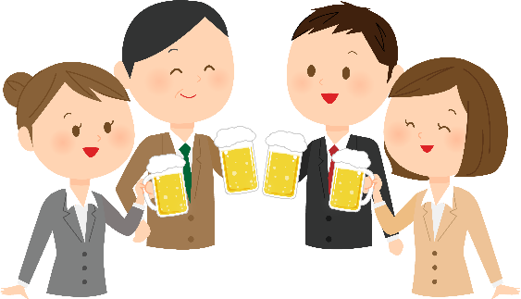
What has been (will be) changed by coronavirus?
★Business trip
★HANKO
★ packed train
★NOMIKAI
★Commuting
（long distance)
Do we need to live in urban area?

Slide 2
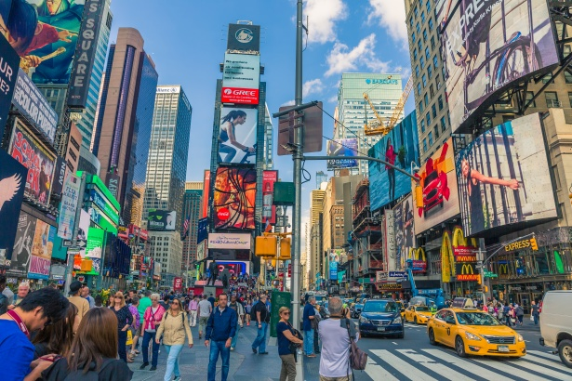
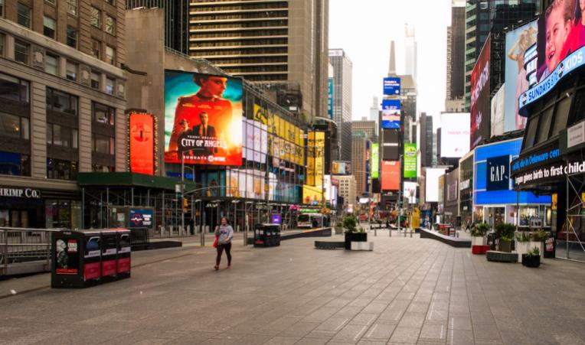
New York city. Restaurants Public services reopened
★Partnership for New York City says only about 8% of office workers are back at their desks.
★Many residents have moved to less expensive areas
Times square past
current

Slide 3
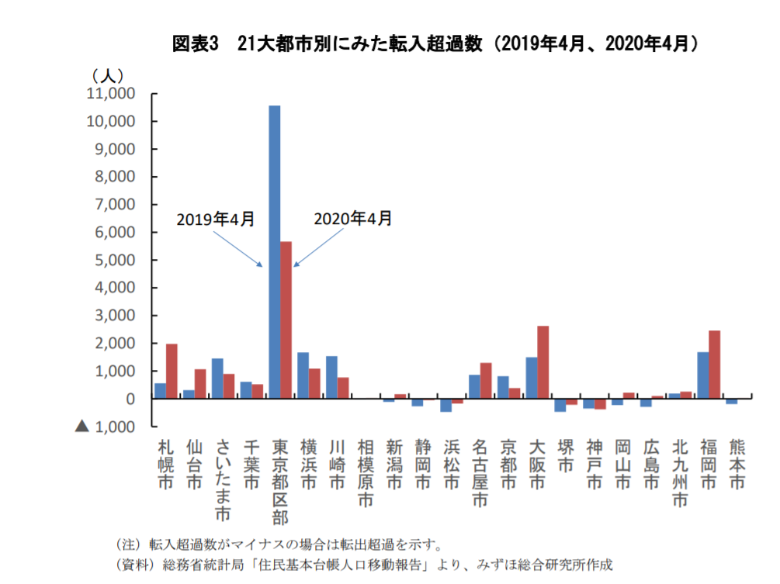
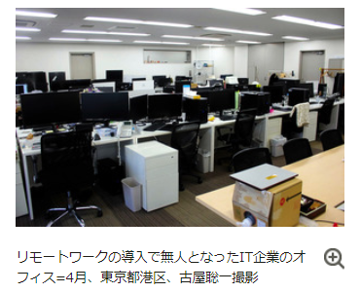
Population concentration will be slow-downed?

Slide 4
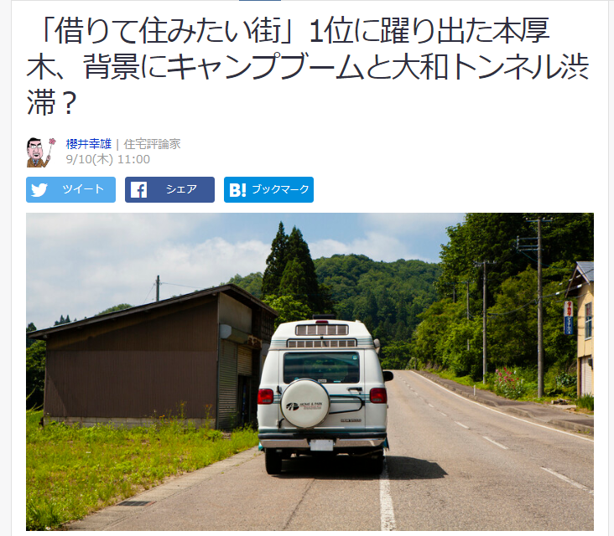
Honatsugi-Most favorable town to rent houses
Big shopping mall close to the station
10 minutes walk to residential areas
50 min train ride to Shinjuku without transit
Close to camping area with no traffic jam
No.2 Kasai 20 min to Otemachi
No.3 Omiya 25 min to Ikebukuro
https://news.yahoo.co.jp/byline/sakuraiyukio/20200910-00197385/

Slide 5
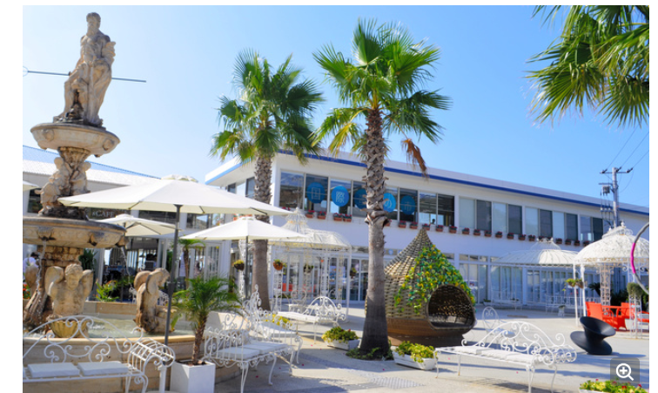
PASONA HQ moving to Awajisima
Regional revitalization project
HQ moving
invest
Cost down
Q o L for employees
Awajisima
Inbound effect
Asahi newpaper

Slide 6
Global warming will be slow-downed?
Less industrial activities
Less traffic
CO2
?
★Researchers estimate that the direct effect of the pandemic-driven response will be negligible,
0.01 ± 0.005 ℃ by 2030 vs a baseline scenario that follows current national policies.
★ In contrast, with an economic recovery tilted towards green stimulus and reductions in fossil fuel investments, it is possible to avoid future warming of 0.3℃ by 2050.
Piers M. Forster, et. al. ‘Current and future global climate impacts resulting from COVID-19’ Nature Climate Change ,07 August 2020

Slide 7
Catering Food-How to make single-use more sustainable?
From cacao shell
From sugar cane bagasse
Pulp mold cover
Craft paper cup
Fromファルカタ
Craft box
Bio plastic

Slide 8
\740/50p
豊和 DINING+ (https://foodfun.jp/archives/6025)

