Slide 1
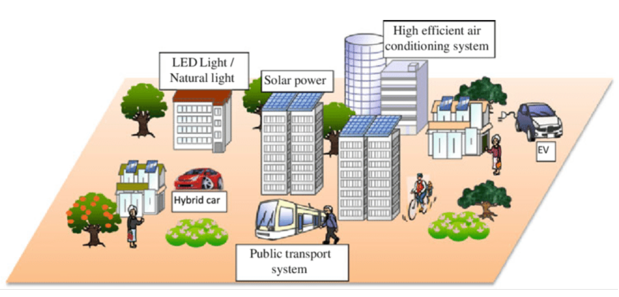
Compact city (2012 OECD) meets the needs for pandemic prevention?
The three key characteristics of a compact city identified in 2012 OECD report are;
Dense and proximate development patterns
Urban areas linked by public transport systems
Accessibility to local services and jobs
Cecchi_et_al.,Sustain Sci (2012) 7 (Supplement 1):91–100

Slide 2
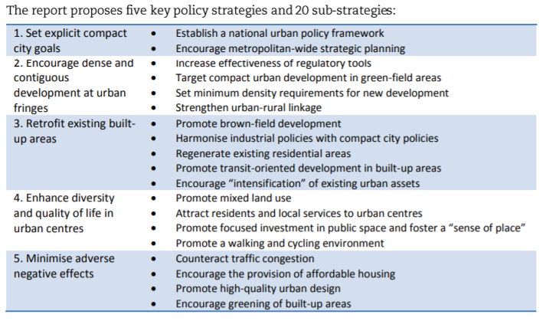
Compact city, key strategies

Slide 3
Compact city Benefit
Environment
Shorter intra-urban distance & less automobile dependency----energy ↓ ,CO2↓
Conserve farmland & natural biodiversity
Local food production----CO2 from food delivery ↓
Economic
Efficiency of infrastructure investment↑、cost of maintenance ↓(transport, energy, water supply, waste disposal etc.)
Easier access to service and jobs
High density of players and functions leads to stimulate knowledge diffusion and economic growth
New green needs----technological development, innovation
Social
Travel cost ↓----mobility of low income household ↑
Nearby local services and jobs----QOL ↑

Slide 4
Sharing economy meets the needs for pandemic prevention?
Sharing Office, Car share, Ride share(Uber), Home stay(Airbnb) X ------ against social distancing
Household chore service (house cleaning, meal delivery(UberEATs)) ○
Bike sharing ○? ------ for commuting, substitute public transportation

Slide 5
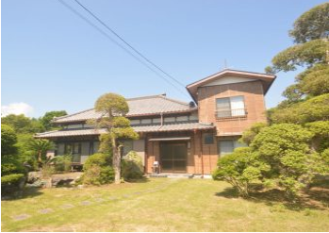
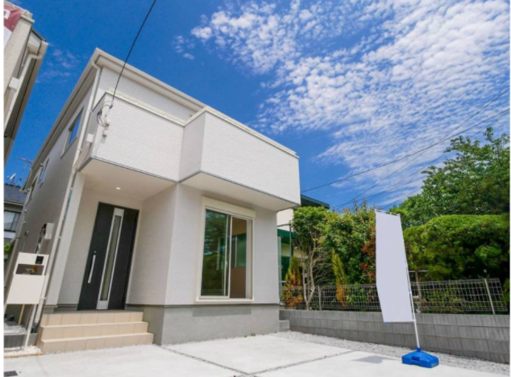
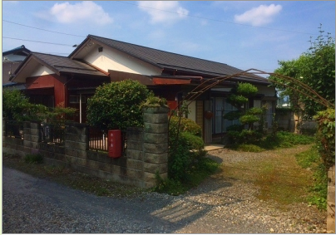
Rural relocation leads environmental preservation?
Online workers
➡ need home offices & no commuting
➡ can move to rural areas where they have larger houses

