Slide 1
Prevention of food loss by Automatic ordering system
田中弘一
出典： ・日本経済新聞 2020年3月13日
・企業診断ニュース 2019年7月 伊藤 伸幸、狩野 詔子 データ活用で生まれ変わった
観光地の老舗食堂 – 三重県 ゑびや

Slide 2
Index
1. Definition of food sold in supermarkets
2. Outlook of Automatic ordering
3. Automatic ordering system by Synopsis Co.
4. Food Loss Rate
5. Introduction effect of automatic ordering system
6. Why is Automatic ordering system needed?
7. Automatic ordering Overseas
8. Case of Ebiya restaurant and souvenir
9. Predictive analysis of visitors using data
10. Procurement of ingredients
11. Results of business reform

Slide 3
1. Definition of food sold in supermarkets
Non food : Daily goods, household goods
General food including processed food : Foods stored at room temperature and can be stored for a long time Example: Seasoning, canning
Daily delivery : Foods delivered daily
Example: Tofu, milk
Daily dish (delicatessen ) and box lunch

Slide 4
2. Outlook of Automatic ordering
Retailers are rushing to introduce Automatic ordering systems.
Recently, there has been widespread movement to Automate ordering systems for foods with short expiration dates such as milk and tofu.
Startup companies and Hitachi are competing for system development because the accuracy of demand forecasts has improved due to the evolution of data analysis.
Automatic ordering systems also solves labor shortages and food waste problems. There are also examples of linking product pricing overseas, changing the retail business model.

Slide 5
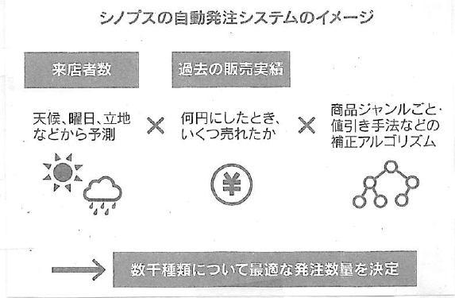
3. Automatic ordering system by Synopsis Co.
Many local supermarkets introduce Synops technology that prioritizes early operation rather than development of their own system. Adopted at Keikyu stores (Tokyo, Minato), Tokyu stores, etc.

Slide 6
4. Food Loss Rate - 1
According to the summary of the Food Industry group,
the ratio of loss caused by discounts and disposal at supermarkets to sales is 1.1% on average for non-food such as household goods.
General food including processed foods such as seasonings etc. It was only 1.7%.
Since all of them can be kept in stores for a long period of time,
the ordering system was simple, such as add a certain number when the stock quantity falls below a specified level.

Slide 7
4. Food Loss Rate - 2
On the other hand, the daily delivery averages 4.2% of the sales, and the daily dish 10.1% of the sales are discounted and lost due to disposal.
If the wrong order quantity is used for the daily delivery and the daily dish, waste will increase.
In the daily delivery and the daily dish area, the automatic ordering system can be most effective.
On the other hand, a executive of major system company said supermarkets and system companies were too slow to introduce unknown the automatic ordering system, because the risk of disposal was too high.

Slide 8
5. Introduction effect of automatic ordering system
The system predicts the number of visitors to the day with approximately 95% accuracy from weather data, day of the week, location of the store, etc.
The system multiplies the past few years of pricing and sales data to calculate a consistent order quantity.
The effect of introduction is clear.
・The number of products that were out of stock because the order quantity was too small, decreased by 30% compared to before the introduction.
・If store order too much, store will be forced to get discounts and discards, but those losses are down about 14%.
・The amount of work per store has been reduced to over 500 hours per year, helping to alleviate labor shortages.

Slide 9
6. Why is Automatic ordering system needed?
Nevertheless, the introduction of the Automatic ordering system is progressing because of the labor shortage.
Yukio Kawano, Chairman of the Japan Supermarket Association said
we are facing an age when continuous growth is difficult with traditional methods and for business development that rely on people.
In fact, Seiyu started using the automatic ordering system developed by Hitachi in October 2007.
It covers about 250 items of lunch boxes and side dishes prepared by Seiyu at its own factory, and has already used it at 44 out of 331 stores nationwide. It plans to expand to all stores by the end of this year.

Slide 10
7. Automatic ordering Overseas
Overseas, pricing is also being automated.
Wastress (Israel), established in 2017, has developed Automatic price setting system based on demand forecasts.
It has been installed in supermarkets in Italy and the Netherlands. The price is calculated based on the data such as the expiration date and the remaining inventory, and it is immediately reflected in the sales floor through the electronic price tag.
This is helping to increase sales at supermarkets and reduce waste loss.

Slide 11
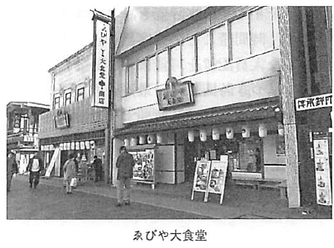
8. Case of Ebiya restaurant and souvenir
Ebiya has been a long-established store in business for over 100 years. The company runs a restaurant and souvenir shop near the Ise Shrine Naiku. Ebiya which was completely renovated about two years ago, is a popular restaurant that is always busy with young female customers.

Slide 12
9. Predictive analysis of visitors using data - 1
A problem of the company is improvement of the profit and sales.
The president has developed a visitor prediction system to solve the problem.
The purpose of the system is as follows.
・Visualization of purchasing and sales data ・Optimization of purchasing and staffing plans ・Business automation

Slide 13
9. Predictive analysis of visitors using data - 2
This system uses various internal data such as the number of visitors, the time of day and the actual order from the POS cash register in addition to external data such as the weather and the number of guests at nearby hotels.
The number of data accumulated so far exceeds 200 items, and by analyzing these data, the forecast of the number of visitors and orders the next day is calculated on an hourly basis.
Its accuracy is very high, and currently achieves a hit rate of more than 90%. Based on this prediction, store operations such as purchasing, preparation, and staffing are optimized.

Slide 14
10. Procurement of ingredients
In terms of purchasing, accurate prediction of the number of visitors has led to a significant reduction in food loss.
Specifically, rice waste has been reduced to one-fourth of conventional levels. In addition, the profits created by efficient purchasing are returned to producers.
By purchasing at a reasonable price without excessive price negotiations, it has become possible to be provided high-quality foodstuffs with high-priority.
As a result, the degree of customer satisfaction has been significantly improved, and high evaluations at gourmet sites such as eating logs have been maintained.

Slide 15
11. Results of business reform -1
Item | 2012 | 2018
Sales | ¥1.1 billion | ¥ 4.8 billion (approximately 4.4 times)
Consumption amount per customer | ¥850 | ¥2,500 (about 3 times)
Rice waste (average daily) | 12kg | 3kg (75% reduction)
Employee holidays | About 1 day per week | 2 days a week

Slide 16
11. Results of business reform -2
Results of system development
・Increase sales and profit ・Reduction of workload ・Fixation of the improvement culture

