Slide 1
Impossible Self-sufficiency
A supplement version of Food Tech

Slide 2
Contents
1. Agricultural reform
2. Basics of Japanese Agricultural Policy
3. Rice and Agricultural products market
4. Trend of Japanese Agriculture
5. Land capacity
6. Mekong delta, Gages delta
7. Japanese tastes
8. World agricultural countries
9. Recent Japanese agricultural policy
10. Climate change
11. Ecology problem
12. Weather condition
13. Smart agriculture
１４．Agriculture technology stolen
Appendix： The future of agriculture realized by digital transformation

Slide 3
1. Agricultural reform
GHQ had done not released agriculture land to Peasant after WWⅡ.
It’s called Agricultural reform.
Land reform was successful at that time.
Land reform created many self-employed farmers. The peasant became happy. However, that delayed the modernization of farmers. Japanese agriculture has become low labor productivity. Japanese agriculture is at stake.

Slide 4
2. Basics of Japanese Agricultural Policy
Peasants voted for the leading political parties in the elections. Political parties demanded that the government provide generous protection for farmers. Agricultural policy guarantees farmers' livelihoods.
JA was established to execute Agricultural policy by Japanese government.
JA has been active as a leader of Japanese agriculture.
Farmers did business to buy many agriculture material and sell agriculture product through JA.
Farmers got enough subsidies. Farmland taxation has been kept low.
However, when there was too much rice, the government took a policy of reduction of rice acreage. The number of fallow fields increased and JA instructed the change from the rice business.
During this time, agricultural and forestry test sites in each region have made a great contribution. Ex. development of Koshihikari and Sasanishiki, etc.
(Boiled frog policy)

Slide 5
3. Rice and Agricultural products market
1. Rice market
(1) Rice stock is excessive.
(2) The biggest agricultural policy of the Japanese government is to maintain rice prices.
Japanese rice is not internationally price competitive.
(3) Food business chains use cheap foreign rice
(4) The surplus rice is used for feed for cows and pigs.
2. Grains
(1) Grains including Cereals, Wheats is controlled by major.
3. Distribution channel
Regarding rice, controlled by JA.
(2) Regarding Grains, controlled by major.
4. Risk
(1) The agricultural market is a free market, but politics is greatly influenced. (2) The agricultural market is also heavily affected by climate change.

Slide 6
4. Trend of Japanese Agriculture
1. Three Chan agriculture
Three Chan means Grand father(Jichan), grand mother(barchan), wife(Karchan).
Three Chan agriculture is non-modern industry.
Three Chan agriculture is a side business.
Japanese government, JA will protect Three Chan agriculture.
2. Local production for local consumption
Local production is very popular for Local people.
Ex. Yokohama vegetables, Kamakura vegetables, Kyo vegetables Local vegetables are also sold at the roadside station.
3. Specialty goods
Koshihikari from Uonuma,
Yubari melon, Aomori apple, Tottori grape

Slide 7
5. Land capacity
Land reform has reduced the area of farmland. Especially in Honshu, the land owned by farmers is small and it is even smaller due to the policy of reduction of rice acreage. Hokkaido has vast farmland and efficient agriculture is carried out. The value of agricultural production in Hokkaido accounts for 14% of the total value of agricultural production in Japan and it is a food base in Japan.
Chinese and Koreans have moved Hokkaido are profitable from farming in Hokkaido. Their agriculture is modern, such as using pesticides in the American way. Ex. Yubari City and Rankoshi town are popular with them.
Rankoshi town

Slide 8
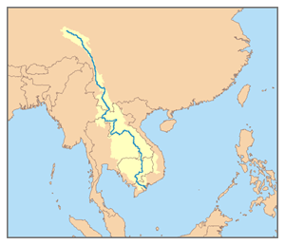
6. Mekong delta, Ganges delta
The Mekong and Ganges deltas are suitable for agriculture. Rich in water and tropical climate suitable for crops. Triple croppings are also possible. It also has a rich population and is a major base for agricultural products. It will also be an export base for agricultural products. In addition, Mekong Delta can also produce Japanese rice.
The rice is imported into the fast food chain as commercial rice.
Japanese agricultural products cannot win.
Mekong delta
Mekong delta
Source: bing.com/images

Slide 9
7. Japanese tastes
Japanese tastes have changed
Japanese travel abroad and are accustomed to foreign rice. Also, we eat foreign rice at the fast food chain restaurant. Therefore, Japanese people do not feel resistance to eat foreign rice.
However, the taste of new rice is very good. Every fall, farmers send new rice to their relatives, friend and acquaintances.

Slide 10
8. World agricultural countries
The three major grain producers, the United States, Australia and Brazil, have a great influence. It is impossible to beat these countries.
Wisconsin, USA, is a dairy kingdom, but something has changed. Many farmers are out of business due to corona infection Subsidies from the Trump administration have no effect. Economic disparities are widening in agriculture as well.
The incident in the United States affects Japanese agriculture. In other words, Japan is under pressure to increase imports of agricultural products.
In addition, China, which is a major food consumer, has a great influence.

Slide 11
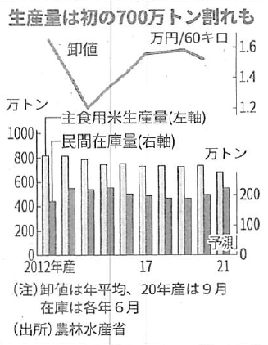
9. Recent Japanese agricultural policy
Ministry of Agriculture, Forestry and Fisheries 2021 outlook Reduced the largest production of rice ever by 560,000 tons. The reason is the collapse of rice prices due to excess rice. Requests to six prefectures including Niigata and Akita prefectures to take the reduction rice acreage.
The government pays farmers a subsidy of 400 billion yen every year for policy of reduction rice acreage. Japanese rice is delicious and is popular overseas. The export value of rice is 4 billion yen. In order to increase the value of rice exports, it is necessary to increase competitiveness and increase production. The government should change its reduction policy.
Boiled frog policy
Source: Nikkei 2020.10.17
Export of 1.5 trillion yen is possible.

Slide 12
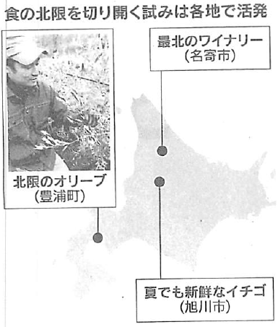
10. Climate change
Northern limit
The northern limit of cultivation has advanced to Hokkaido due to climate change Overcome the cold.
The types of crops are changing
Source: Nikkei 2020.10.16

Slide 13
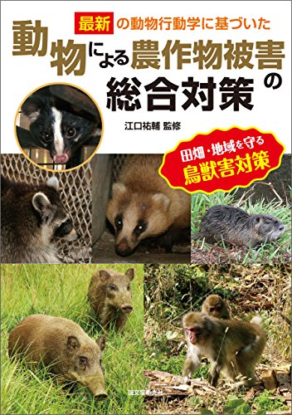
11. Ecology problem
Damage to crops by animals
Bears, deers, monkeys, birds
Habitat is out of food.
The damaged area is the partial area.
Ex. Monkey
Number of monkeys in western
Kanagawa Prefecture
Odawara
Source: https://www.amazon.co.jp/動物による農作物被害
Source: Kanagawa Prefecture

Slide 14
12. Weather condition
Weather science X Computer technology
WEATHERNEWS INC.
Weatherthech（WxTech ™）
All data based on natural phenomena from official data released by the Japan Meteorological Agency to original content. Not only weather forecasts and past weather data, but also data with disaster risks such as earthquakes, tsunamis, and volcanoes. In addition, data related to human life and health such as cherry blossom prediction, pollen scattering amount, heat stroke, ultraviolet rays, viruses, and weather pain. We can provide all kinds of data related to natural phenomena.
Weather data is useful in all areas. For example, Food Tech
Sora-Tenna
High performance weather IoT sensor
Source: WEATHERNEWS INC. HP

Slide 15
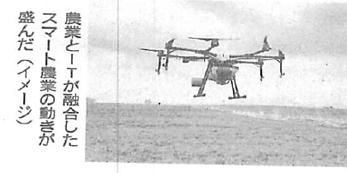
13. Smart agriculture
Source: Nikkei 2020.10.16
(1) Drone
Agriculture is effective for Doron. The biggest operational issue is the weather condition.
(2) AI
To improve production efficiency, AI is used to grow grapes, which are the raw material for wine.
AI is used in greenhouses to prevent diseases of agricultural products such as tomatoes and cucumbers.
(3) Satellite image
Satellite images are used together with drones to observe the growth of crops. Example: tea, grapes, grains, etc.

Slide 16
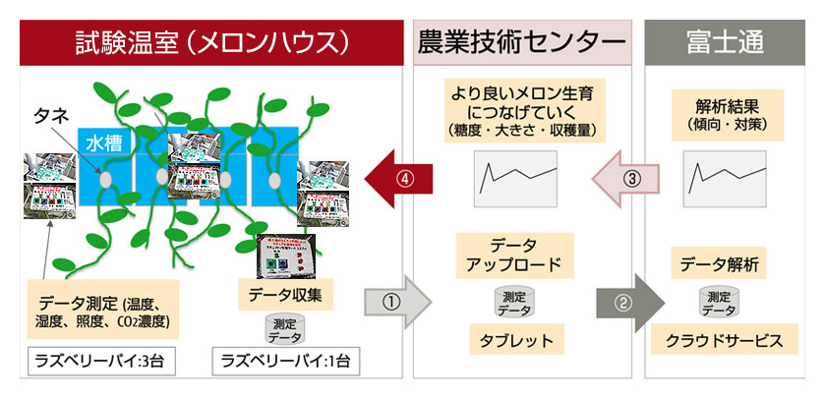
13. Smart agriculture
(4) GPS(Global Positioning System)
GPS dramatically increases the efficiency of agricultural production.
Source: Kubota HP
(5) IoT/ICT・DX
Digitalization is essential for agriculture. For example IoT/ICT・DX.
High quality melon cultivation by IoT
Source: FUJITSU JOURNAL 2019.10.4
(6) Modernization
Agricultural modernization is essential for improving self-sufficiency. Ex. rushing to establish an agricultural corporation.

Slide 17
１４．Agriculture technology is stolen
(1) Anti-theft
Agricultural technology has been stolen. It is necessary to take measures against theft as soon as possible.
(2) Exercise of patent rights
Register a patent for agricultural production. Protect agricultural products from patent infringers.
(3) Trademark right registration
A trademark of companies in Aomori Prefecture is registered in a certain country. As a result, companies are unable to export to a certain country.

Slide 18
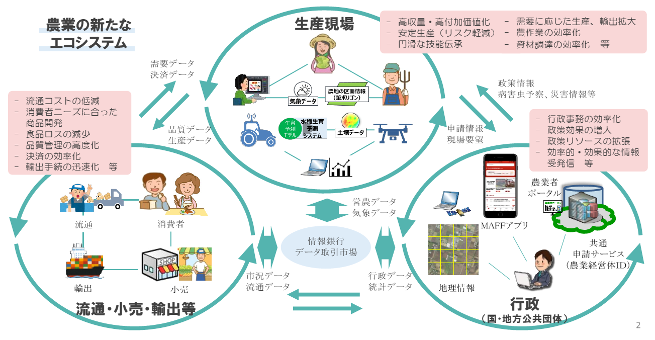
Appendix： The future of agriculture realized by digital transformation
Source：Ministry of Agriculture, Forestry and Fisheries

