Slide 1

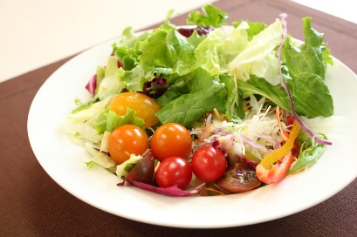
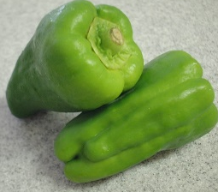
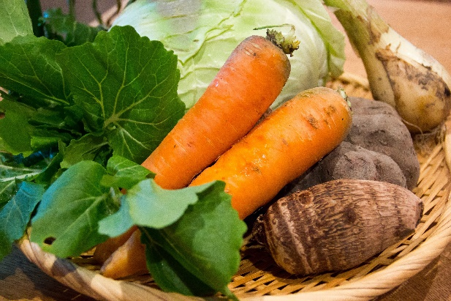
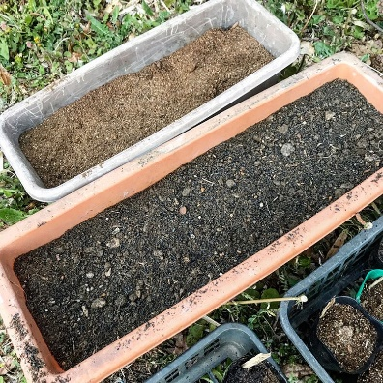

Food recycling???
Paprika grown from kitchen garbage at my balcony
Can reduce plastic bag for garbage collection

Slide 2
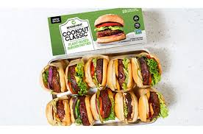
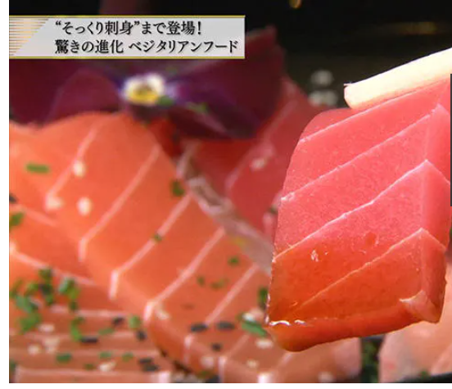
Food Tech
Plant to meat or fish is getting popular aiming to sustainable food supply
@ BEYOND MEAT
https://www.tv-tokyo.co.jp/plus/business/entry/2019/018816.html

Slide 3
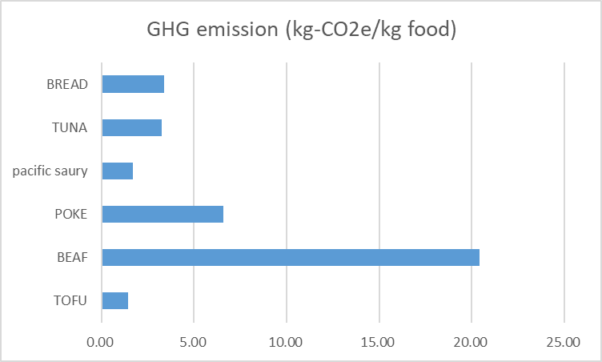
Global warming potential of Food production
Ref:IDEA v2.3 AIST

Slide 4
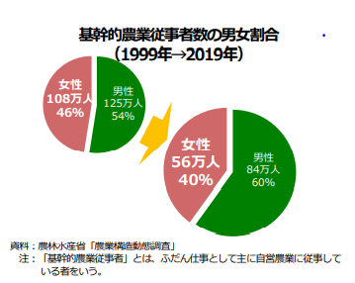
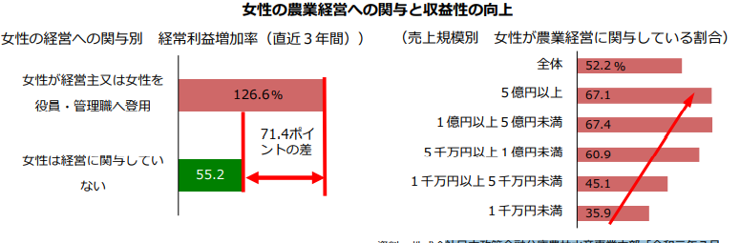
Population of Farmers- getting smaller
Female farmers are involved in management more than they were in the past.
Ref: MSF White paper 2019

Slide 5
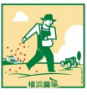
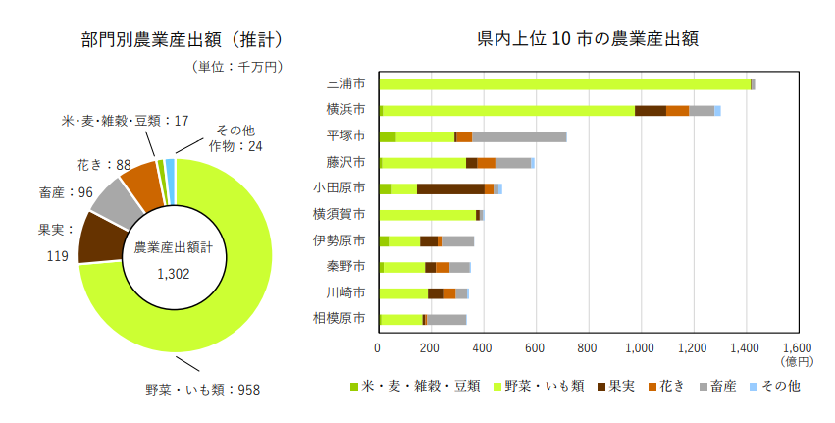
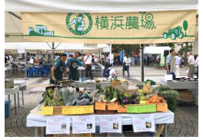
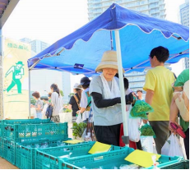
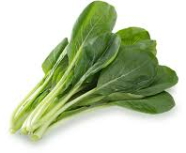
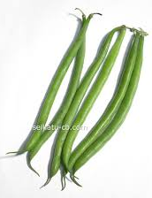
Agri Production in Yokohama
Ref:Agriculture in Yokohama( Yokohama city)2019
National top production

Slide 6
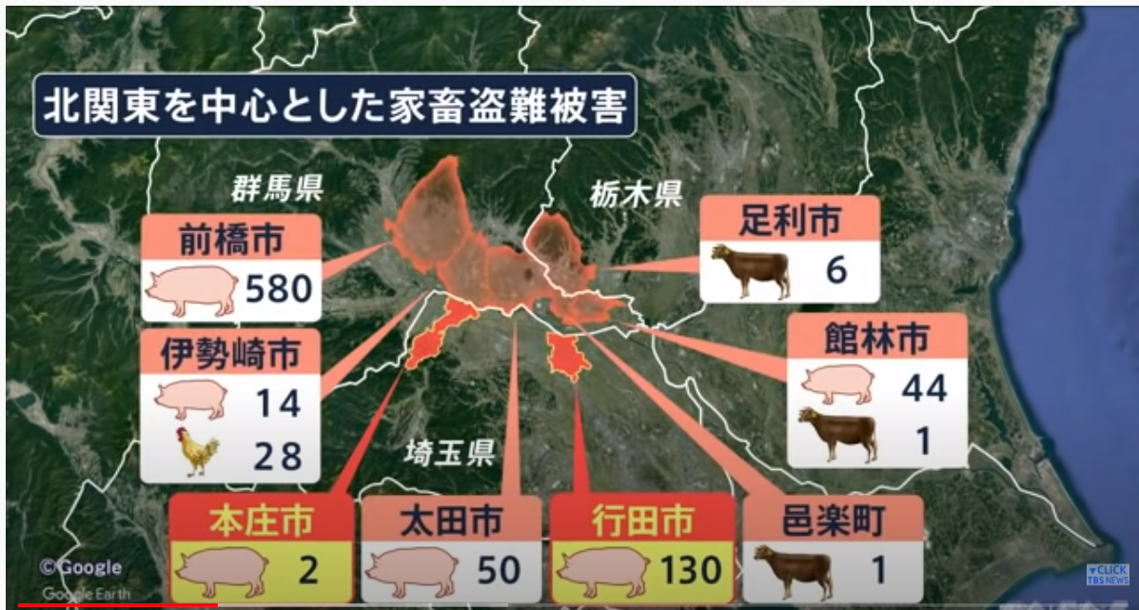
Livestock steal
https://www.youtube.com/watch?v=o94JfLo7nCA

Slide 7
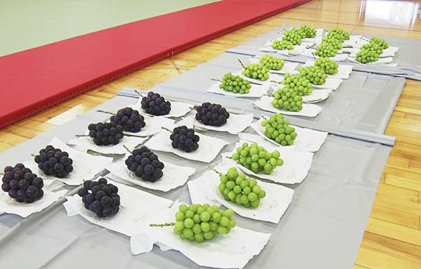
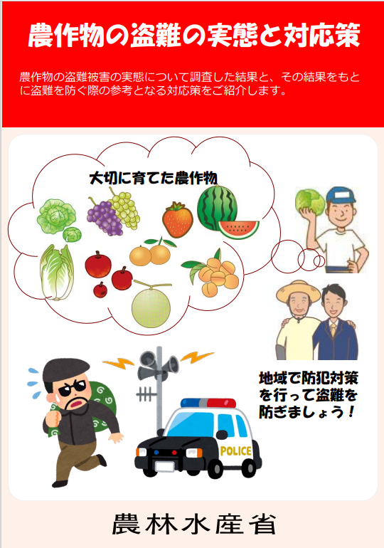
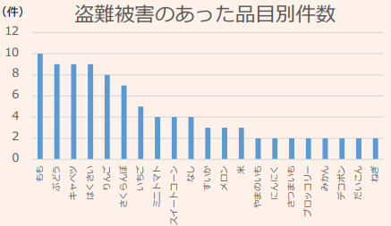
Fruit & vegetable steal
\42,000
Shine muscat is target this year
@NHK
MAF’s survey
In 2018

